Slide 1
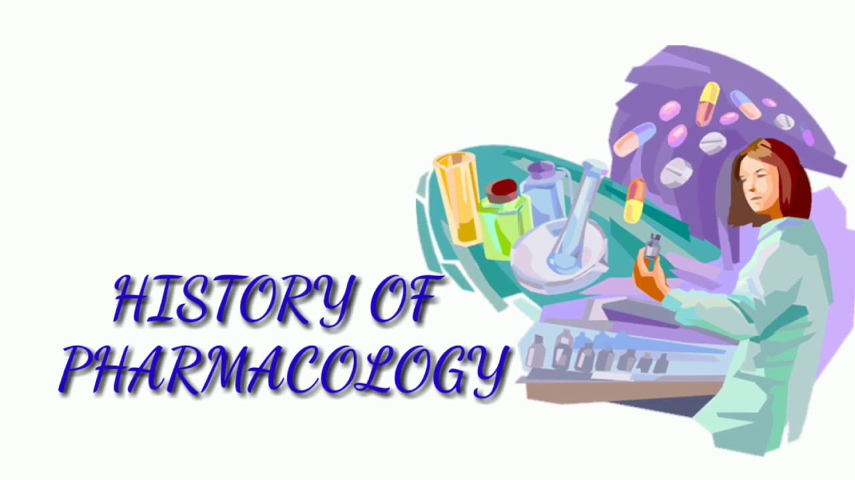
Chapter 1 Vocational Nursing Pharmacology

Slide 2
Pharmacology Chapter 1
KEY TERMS
Al-Hawi
Alternative medicine (al-tĕr-nā´tuvmed´ĭ-sin)
Antineoplastic (ant´´i-nē´´ŏ-plas´tik)
Bovine (bō´vīn)
Curative (kū´ră-tĭv)
Destructive (duh·struhk·tuhv)
Diagnostic (dī´´ ăg-nos´tik)
Drug/droog (drŭg/drôge)
Ebers papyrus (Ebers puh·pai·ruhs)
Palliative (păl´ē-ā´´tĭv)
Pharmacodynamics (făr´´mă-kō-dī-năm´ĭks)
Pharmakon (făr´´mă-kn)
Porcine (por´sīn´´)
Prophylactic (prō´´fī-lak´tik)
Replacement drugs (ri-plās´mĕnt drŭgs)
Synthetic drugs (sĭn-thĕt´ĭk drŭgs)

Slide 3
History of Pharmacology
In this lecture, you will learn about the history of pharmacology and sources used for developing drugs; the acceptance of alternative medicine, and its place in medicine; and the six main categories of drugs and their uses.
Many ancient cultures have contributed to the knowledge base and evolution of pharmacology, including Greek, Chinese, Egyptian, Persian, and Arabic. The healers were called by many names, but all shared extensive knowledge of plants, minerals, and animal products.
“Healers” were known as wise men, shamans, witch doctors, medicine men and women, and so on (Fig. 1-1), depending on the culture, and were chosen based on their knowledge of which plants or other substance to use, how to prepare it, and how much to give the patient.
The term pharmacology is of Greek origin from two words: pharmakon, meaning “medicine,” and ology, meaning “the study of.”
Pharmakon also meant poison and remedy, poison because some of the early medicines were toxic enough to kill, and remedy because, at times, early medicines cured the illness. The word drug has a Dutch origin in which droog meant “dry” as in the use of dry herbs.
Alternative medicine: the practice of using natural healing in conjunction with mainstream medicine. Some examples are acupuncture, massage therapy, and aromatherapy.

Slide 4
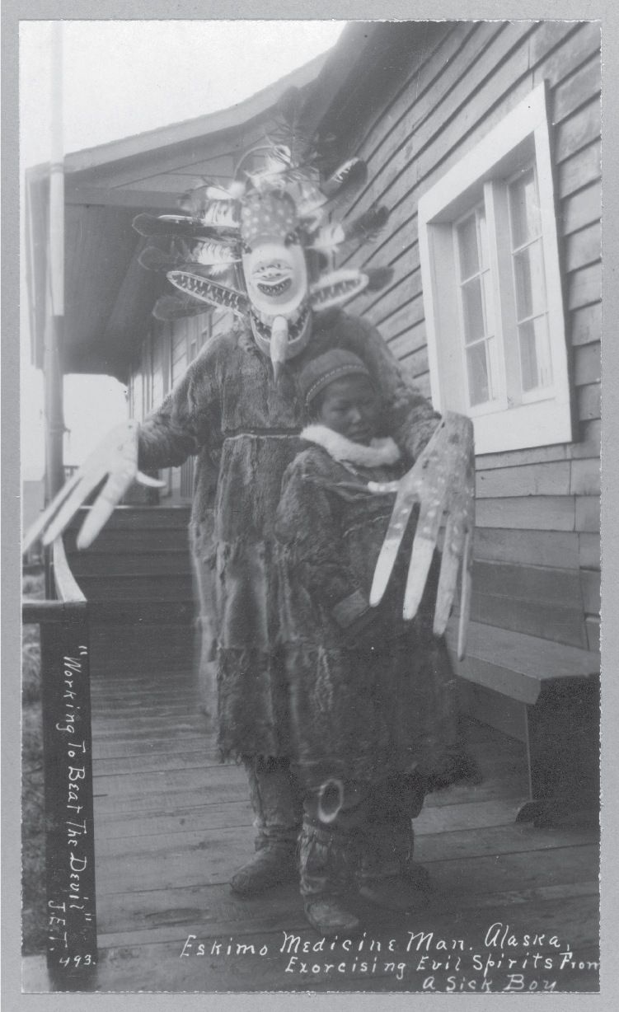
Pharmacology in Ancient Times and Cultures
“The Yellow Emperors’ Inner Classic,” a Chinese document, was a very early discussion of yin-yang and acupuncture. The first Chinese manual on pharmacology was written in the first century AD and included 365 medicines, 252 of which were herbs.
In Egypt, a medical document called the Ebers Papyrus was written circa 1550 BC and lists about 700 “recipes” for a host of illnesses, from crocodile bites to psychiatric illnesses.
The Al-Hawi, is a large, 20-volume medical book written by the physician Al-Razi in ancient Persia (Iran). It was translated into Latin in the 13th century and greatly influenced medicine in medieval Europe.
FIGURE 1-1 Eskimo medicine man. (From the Library of Congress Prints and Photographs Division, Washington, D.C.)

Slide 5
Pharmacological Advances Through the 19th and 20th Centuries
The contributions from these cultures led to the advancement of pharmacology. When treatments for many conditions were discovered, the findings were recorded on papyrus or paper to pass on to future generations.
Documenting this early information was extremely important, as belief systems changed over time. Without these earlier writings, traditional oral knowledge might have been lost or suppressed and much progress could not have been made.
During the 1800s, chemists were able to identify and then isolate the active ingredients (those pure chemicals in the plants that had the actual therapeutic properties). They were also able to determine how the drug acted on the body. This marked the beginning of modern pharmacology.
Not until World War II (1939 to 1945) did the mass production of medicine begin (Fig. 1-3).
More U.S. soldiers died in World War I from infection and accidents than from actual combat injuries; however, the mass production of penicillin minimized the number of deaths from infection during World War II (Table 1-1).
For instance, the death rate from pneumonia in the U.S. Army was 18% during World War I, decreasing to 1% during World War II. Death from combat injuries complicated by infections also decreased.

Slide 6
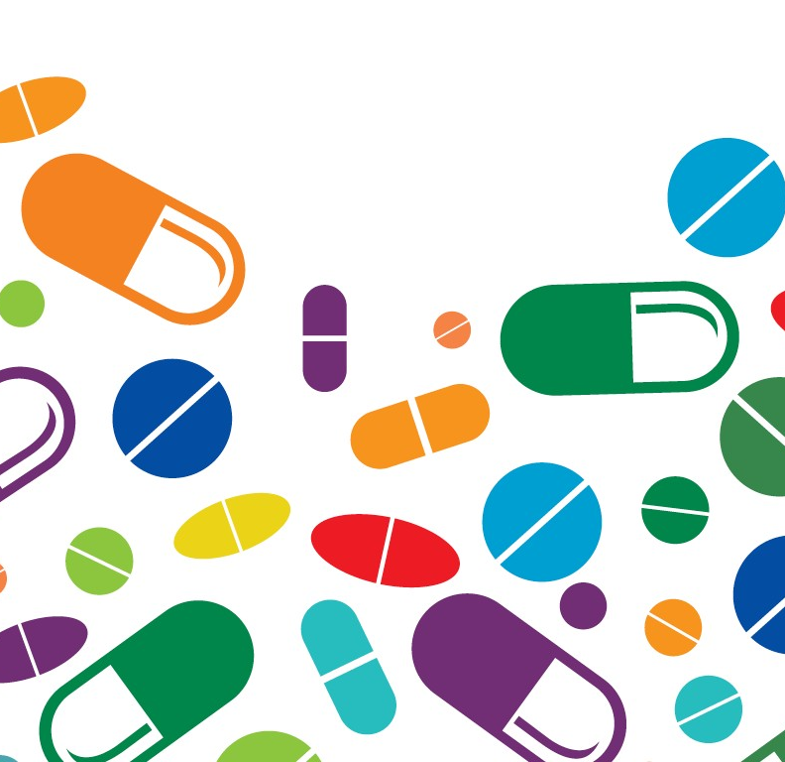
Pharmacological Advances Through the 19th and 20th Centuries
In an effort to discover possible new drugs, researchers studied plants, marine animals, and microorganisms in the soil, water, and air.
Partially or totally synthesized medications were produced by combining two or more compounds or elements.
Partially synthesized medications were made by adding a pure chemical to a natural substance.
Totally synthesized medications were created by combing two or more pure chemicals to produce a new substance that could be used as a medication.
One major breakthrough was the discovery of ways to create large amounts of viable drugs from a small number of natural resources using genetic engineering.
For example, human insulin can be mass-produced by adding the human insulin gene to a nonpathogenic strain of Escherichia coli.

Slide 7
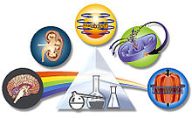
Pharmacology in the 21st Century
One of the most promising advances in the field of medications is that of pharmacogenetics, which is the “study of individual candidate genes as powerful tools to explain interindividual variability in drug response.”
The patient’s genetic material is analyzed, and then in the case of cancer, the tumor’s genetics are analyzed to figure out the best drug and what dosage will work best to combat the disease.
Currently, there are certain medications and doses used to treat conditions for every adult patient with that condition.
Through these advances in pharmacogenetics, the ability to individualize drugs and their dosage is happening in the treatment of HIV and rheumatoid arthritis.
In addition, the hope is that in the future we can specifically tailor drugs and dosages for opioids and antihypertensives, among other medications.

Slide 8
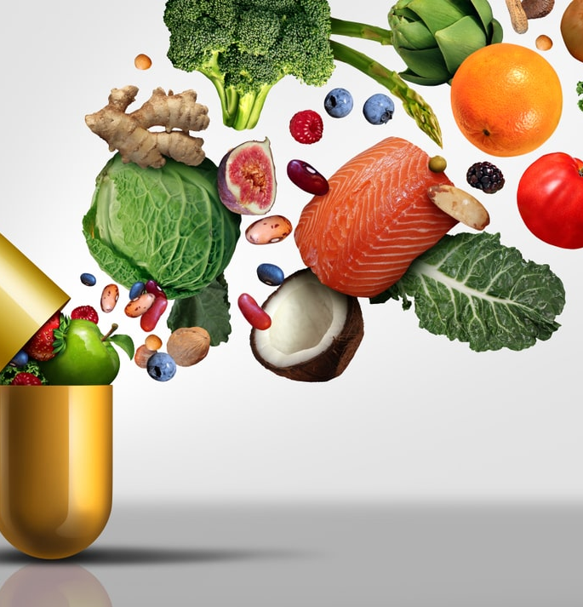
SOURCES OF DRUGS
Although most drugs are now manufactured in laboratories, many agents are still derived from natural substances such as plants, animals, minerals, and toxins. Some are utilized by extracting active ingredients from animals or plants and using these ingredients to manufacture medication.
Some drugs are made by combining chemicals with natural products, such as hydrocodone, which combines natural opium in the form of codeine combined with acetaminophen (a man-made medication), whereas other drugs are synthesized in a laboratory.
Barbiturates are an example of synthetic drugs because they are chemically derived from barbituric acid (itself an artificial compound of urea and malonic acid).
Examples of drug sources: Plants, Animals, Minerals, Toxins, Synthetics

Slide 9
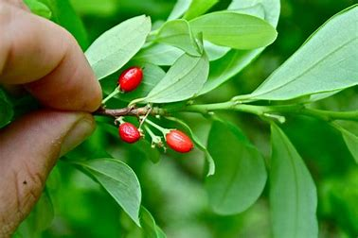

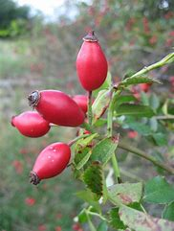
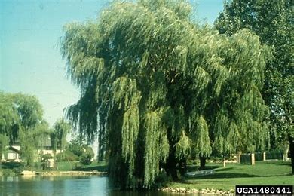
Plants: Today, plants are rarely used as medications; the active component of the plant is extracted and utilized
Digoxin (Lanoxin), a drug used to treat heart failure, is made from the foxglove plant and has been used for healing since the 1500s.
Most estrogen hormone replacements come from yams.
Procaine (Novocain), used as an anesthetic, is derived from the coca plant.
Rose hips are a rich source of vitamin C and are sold as an ingredient in vitamin C supplements.
Aspirin (acetylsalicylic acid) is a compound based on salicin, which is found in the bark of a white willow tree and is used to relieve pain and to treat inflammation.
Rose hips – Vitamin C
White willow tree - ASA
Foxglove - Digoxin

Slide 10
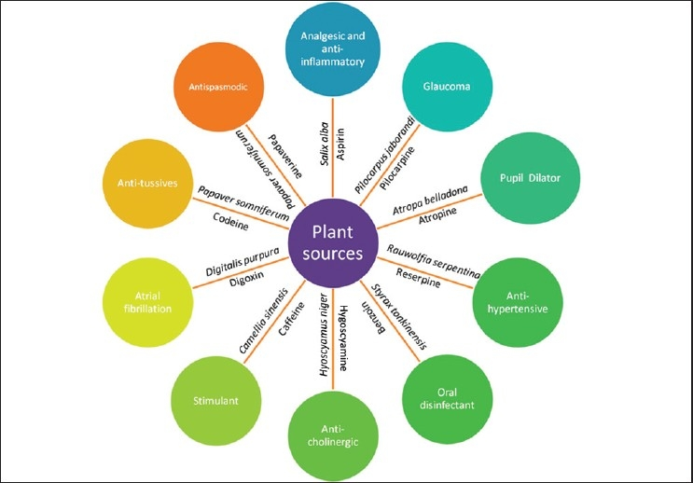

Slide 11
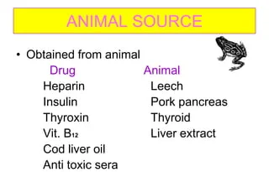
Animals: Domesticated animals are also a source of drugs.
To ensure the purity of the drugs, donor animals are generally well cared for.
Examples include sheep, which provide lanolin, a topical skin medication that comes from wool.
Cows (bovine) and pigs (porcine) are good sources of hormone replacements. If a patient’s body cannot manufacture a hormone, animal hormones can serve as a substitute.
Horses provide humans with the replacement hormone conjugated estrogen (Premarin), which comes from a pregnant mare’s urine.
Insulin is collected from the pancreas of cows or pigs.
Immunoglobulin G (IgG) by injecting an antigen into animals (most commonly cows) and collecting the antibody that is formed.
Heparin is extracted from porcine intestinal mucosa and bovine lungs.
Snake venom is used for thrombosis, arthritis, cancer treatments

Slide 12
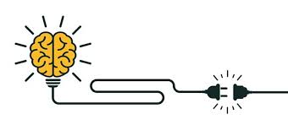
CRITICAL THINKING
Muhammed A. is a devout Muslim. He does not eat pork. What is the best choice of insulin for him? Explain your rationale for this choice.

Slide 13
Minerals: When foods grown from rich soil are unavailable, calcium, iron, zinc, magnesium, copper, and selenium are some of the minerals that are offered as necessary supplements.
For patients taking certain medications, mineral replacement is critical.
Diuretic drugs such as furosemide (Lasix) cause the body to lose excess water through the kidneys, and potassium, a vital mineral, is also excreted with the water.
Potassium is needed for the heart to function normally, so supplemental potassium chloride is frequently prescribed in addition to the medication. Potassium is also contained in sweet potatoes, bananas, and oranges.
Minerals are also used to treat certain conditions. For example, gold is used in the treatment of arthritis, iodine is used to treat goiter, and magnesium sulfate is used for constipation and eclampsia.

Slide 14
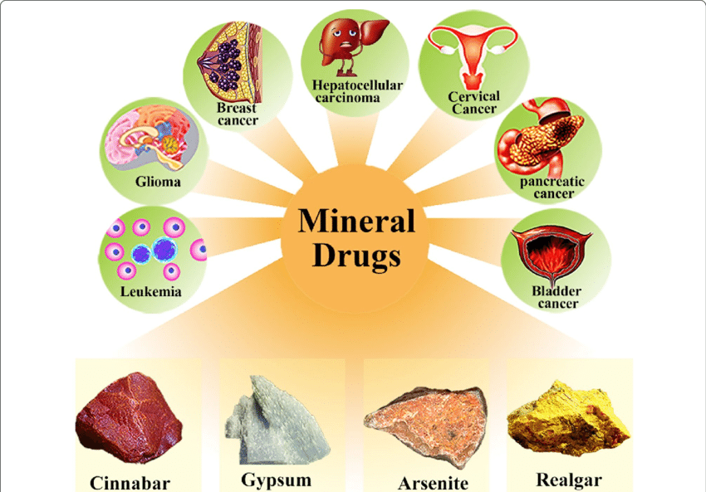
Cinnabar: improving vision, detoxification, insomnia, epilepsy, palpitations
Gypsum: high fevers, headaches, toothaches, painful gums, eczema, burns, skin ulcers
Arsenite (chemotherapy): acute myeloid leukemia – AML
Realgar: mouth ulcers, tongue ulcers, headaches

Slide 15
Toxins: chemical and biological toxins are commonly used in medicine. The key is in the dosage.
Certain radioactive chemicals are used to diagnose and treat illnesses.
Radioactive iodine, for example, in small doses can help pinpoint problems in a patient’s thyroid, a small gland in the neck.
In higher doses, radioactive iodine is used to shrink thyroid tumors.
Biological toxins can also be used in medicine.
Botulinum toxin (Botox), which comes from a bacterium called Clostridium botulinum, is used for severe muscle stiffness, spasticity, dystonia, and neuropathic pain.
Torticollis (a condition in which neck muscles contract causing the head to turn to one side), strabismus (eye misalignment), and migraines. It is used in tiny doses.

Slide 16
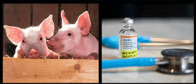
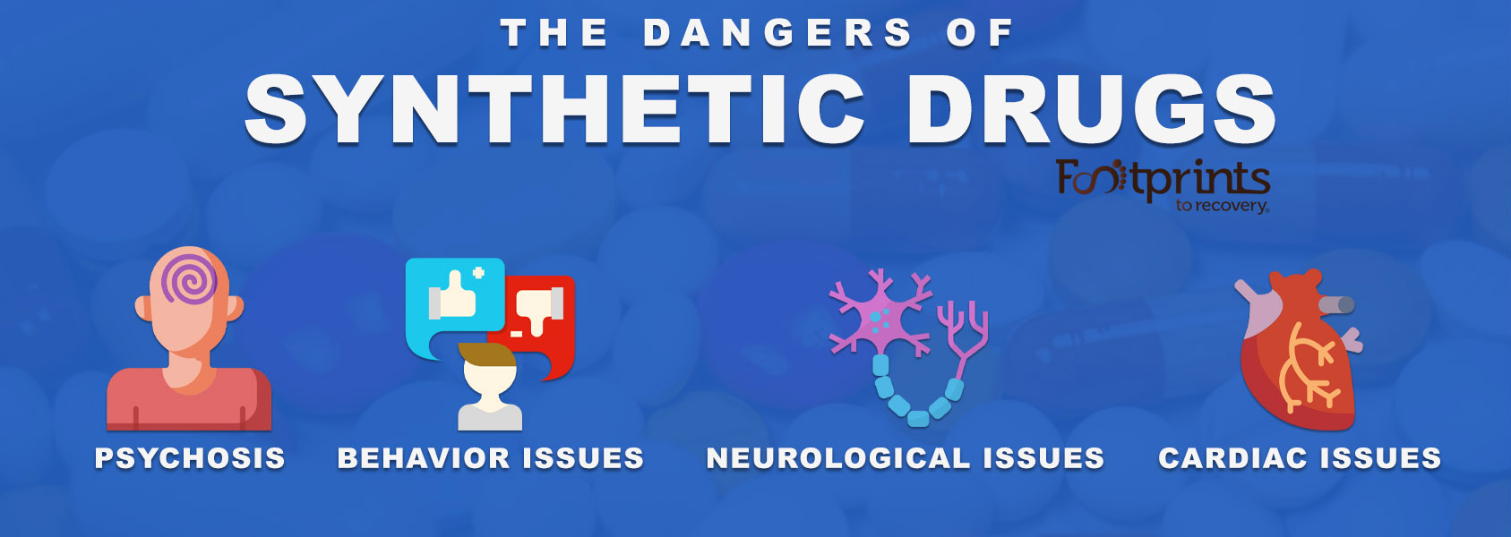
Synthetic Medications: created by chemical processes, by genetic engineering, or by altering animal cells. Often, drugs that are obtained from another source can be synthesized in the laboratory, thus preserving natural resources.
Insulin can be obtained from pigs or cows, but a synthetic source is most commonly used.
An advantage of synthetic medications is usually more inexpensive because they are mass-produced.
Disadvantage of synthetic medication are psychosis, behavior issues, neurological issues, cardiac concerns.

Slide 17
CATEGORIZING MEDICATIONS
Pharmacodynamics refers to the effects of a drug on the body, or more scientifically, the negative and positive biochemical or physiological changes that a drug creates. Drugs fall into six categories of desired effects (Table 1-2).
Curative. Some drugs restore normal physiological function, as in diuretics, which help the body rid itself of excess fluid.
■ Prophylactic. These drugs prevent diseases or disorders, as in antibiotics given before surgery to prevent infection.
■ Diagnostic. Some drugs help diagnose a disease, such as barium that patients swallow to help highlight digestive problems on a radiograph.
■ Palliative. Other drugs, such as pain relievers, do not cure disease, but they make patients more comfortable.
■ Replacement. These drugs “replace” missing substances. Levothyroxine sodium (Synthroid), for example, is a drug that replaces a missing thyroid hormone.
■ Destructive. Some medications destroy tumors and microbes. Antineoplastic (anticancer) drugs are an example of destructive, toxic drugs.

Slide 18
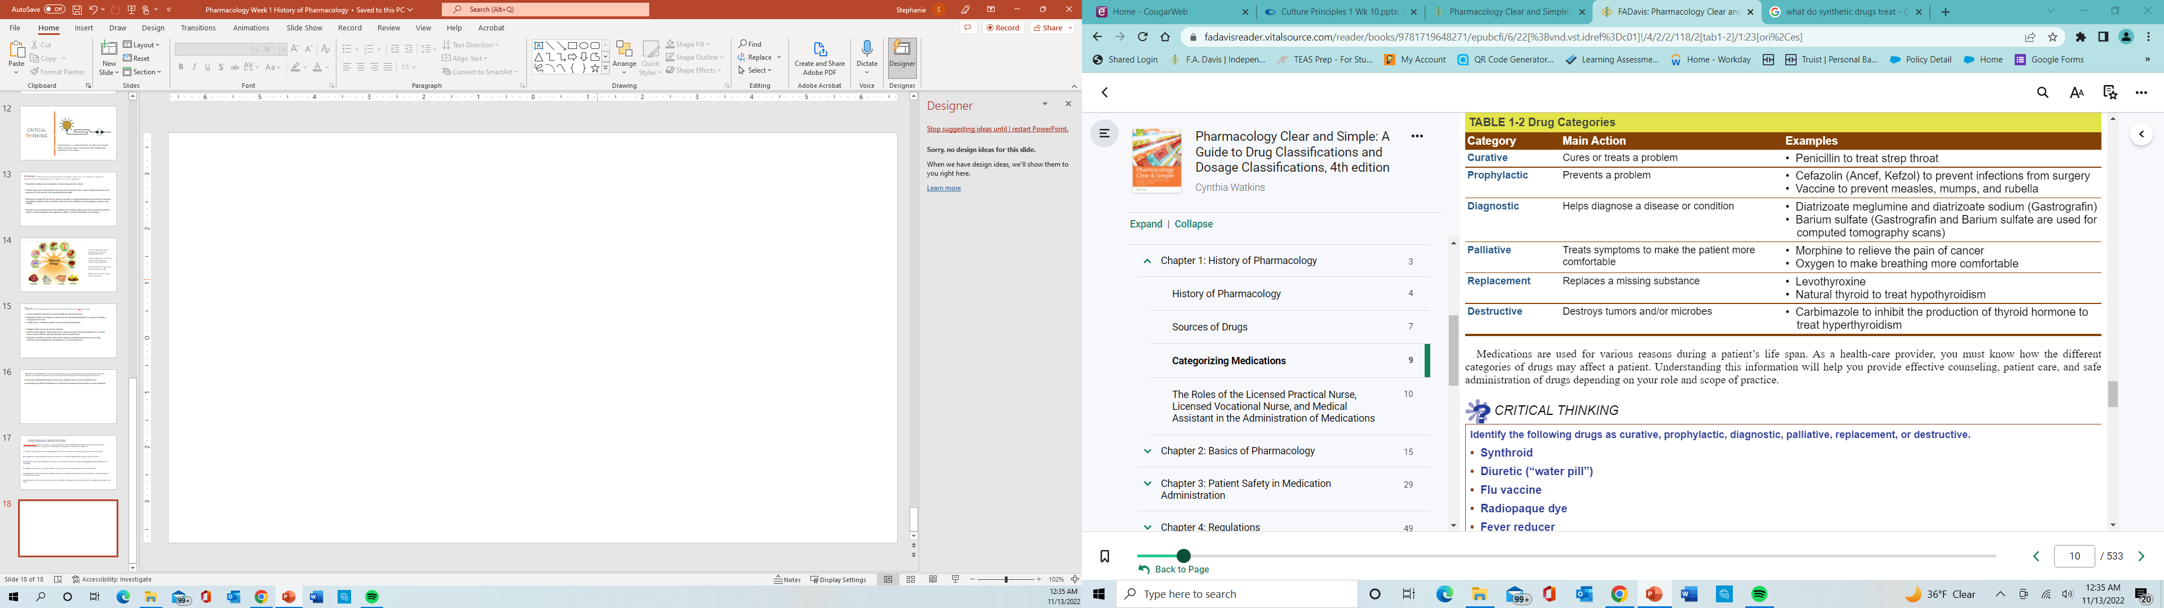

Slide 19

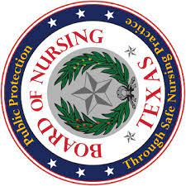

THE ROLES OF THE LICENSED PRACTICAL NURSE, LICENSED VOCATIONAL NURSE, AND MEDICAL ASSISTANT IN THE ADMINISTRATION OF MEDICATIONS
Nurses must work within their scope of practice, based on state laws, and board of nursing statutes. It is important to know your scope of practice in your state so that you can provide the best care possible to your patients while abiding by state regulations.
State Boards of Nursing are the governing bodies that determine the scopes of practice for licensed practical nurses (LPNs) and licensed vocational nurses (LVNs).
LPNs/LVNs generally:
  administer oral, rectal, ophthalmic, otic, intradermal, subcutaneous, intradermal, and intravenous (IV) medications.
  LPN/LVN may not give medications by rapid IV push.
  LPN/LVN not be allowed to administer or monitor IV medications and fluids via a central line (one that is in a large vein close to the patient’s heart).

